Slide 1
IMDB Movie Analysis
Swetha G

Slide 2

Movies

Slide 3
Statistics
The media and entertainment (M&E) industry is estimated at INR 126k cr
While this represents only ~1% of the country's GDP, this makes the sector larger than India's consumer durables and online retail industries.

Slide 4
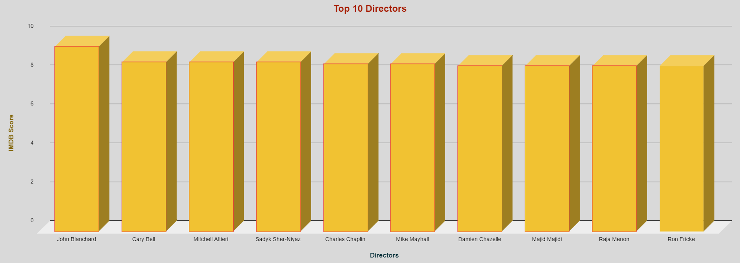
Top 10 directors

Slide 5

Maximum Critic Reviews and maximum user reviews

Slide 6
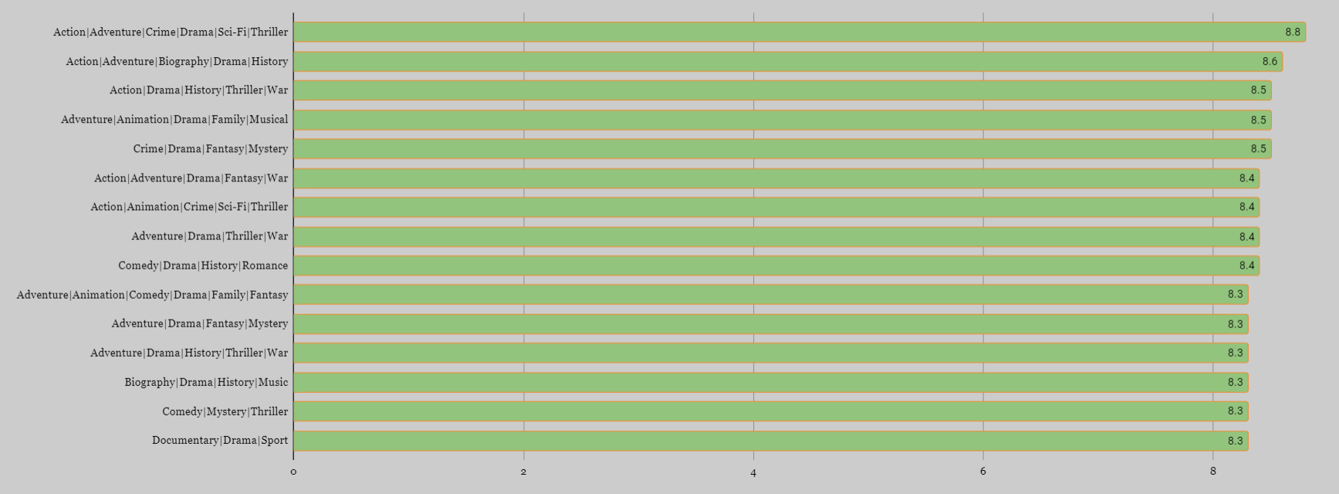
Top genres

Slide 7
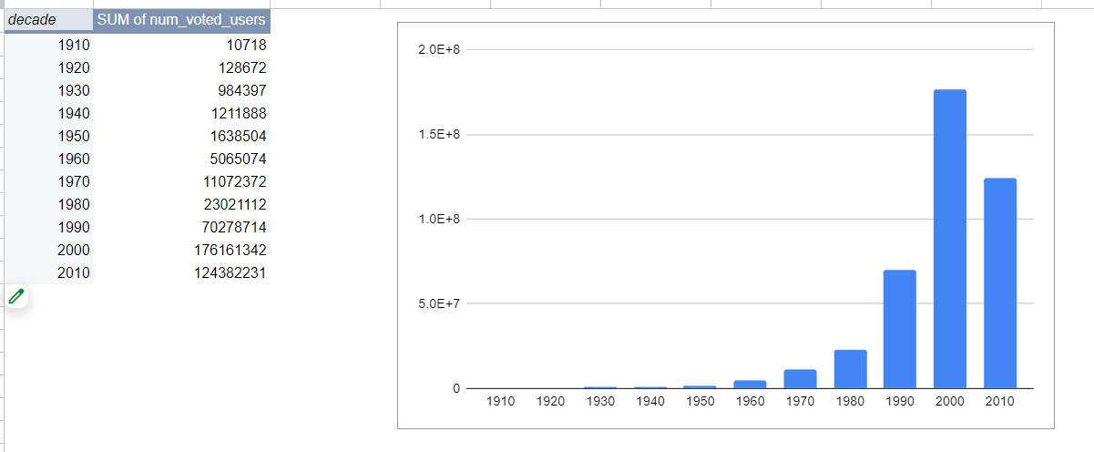
Number of Voted Users per decade

Slide 8
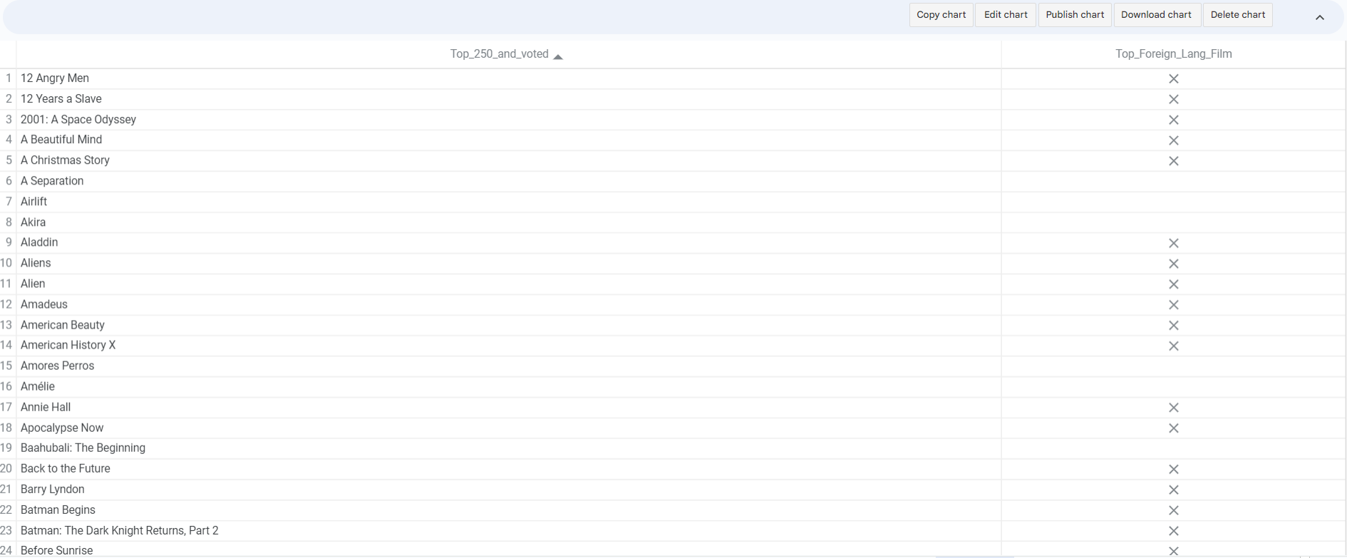
TOP 250 Films and Foreign Language Film
The Shawshank Redemption

Slide 9
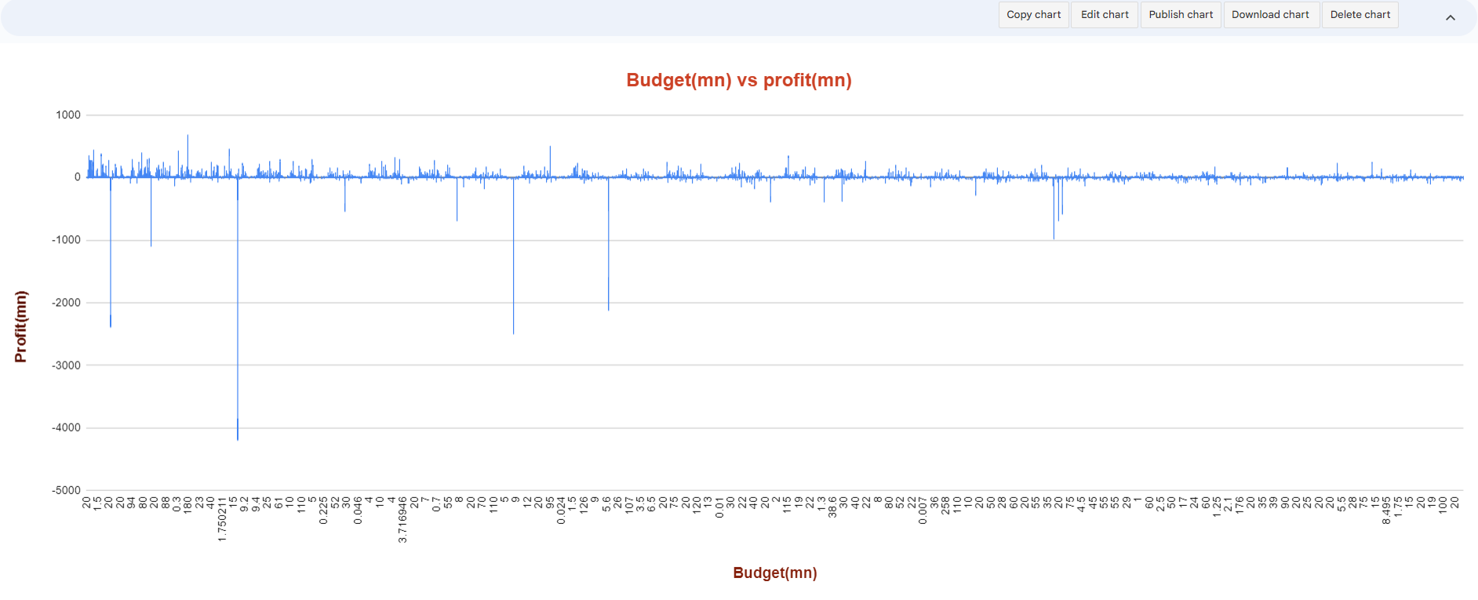
Budget vs profit

